Slide 1
Transmission Control Protocol

Slide 2
TCP SERVICES
Figure 15.1 shows the relationship of TCP to the other protocols in the TCP/IP protocol suite. TCP lies between the application layer and the network layer, and serves as the intermediary between the application programs and the network operations.

Slide 3
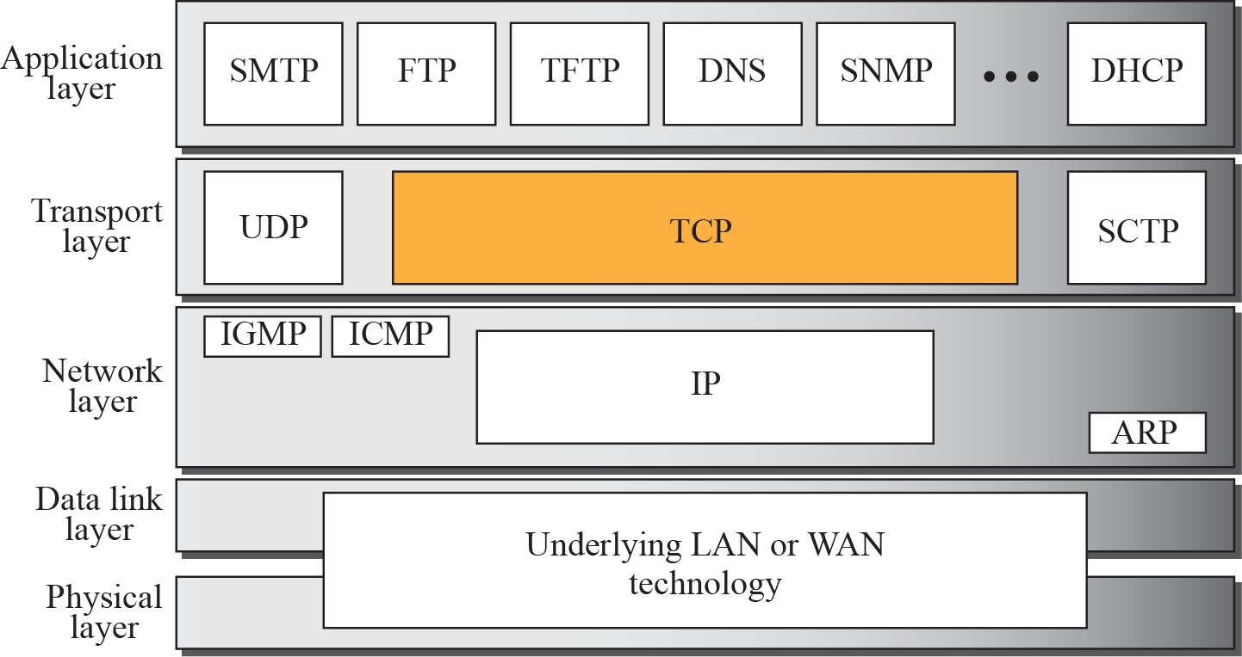
Figure 15.1 TCP/IP protocol suite

Slide 4
Application Layer Expectations
Process to Process Guaranteed message Delivery.
Ordered Delivery.
No Duplication.
Support Arbitrarily large messages
Support Flow Control.

Slide 5
Network Layer Limitations
Best Effort Service model
Packet Losses
Re-ordering
Duplicate copies
Limit on maximum message size (MTU)
Long Delays
Notes:
Best-effort delivery describes a network service in which the network does not provide any guarantee that data is delivered or that delivery meets any quality of service. In a best-effort network, all users obtain best-effort service. Under best-effort, network performance characteristics such as network delay and packet loss depend on the current network traffic load. When network load increases, this can lead to packet loss, retransmission, packet delay variation, and further network delay, or even session disconnect.
Best-effort can be contrasted with reliable delivery, which can be built on top of best-effort delivery (possibly without latency and throughput guarantees), or with virtual circuit schemes which can maintain a defined quality of service

Slide 6
Challenges
Network Layer do not meets the requirements of Application layer expectations.
Therefore additional services needed to meet the application layer expectations.
These additional services are supported by different transport layer protocols like TCP (Transmission Control Protocol) /UDP (User Datagram Protocol)(when Application requirements are simple) .

Slide 7
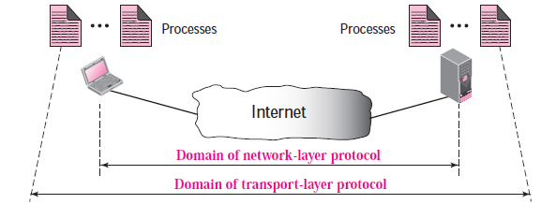
Process to Process Communication
Process to Process Guaranteed message Delivery.
Ordered Delivery.
No Duplication.
Support Arbitrarily large messages
Support Flow Control.

Slide 8
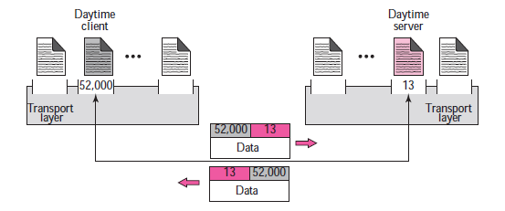
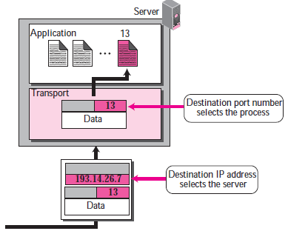
Port Numbers..
How to achieve process-to-process communication in client-server paradigm.

Slide 9
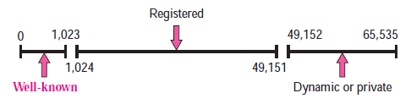
Port Numbers
ICANN has divided the port numbers into three ranges: well-known, Registered, and Ephemeral or dynamic (or private)
Notes:
Well-known ports. The ports ranging from 0 to 1,023 are assigned and controlled by
ICANN (The Internet Corporation for Assigned Names and Numbers) These are the well-known ports.
❑ Registered ports. The ports ranging from 1,024 to 49,151 are not assigned or controlled
by ICANN. They can only be registered with ICANN to prevent duplication. They are assigned by IANA (Internet Assigned Numbers Authority)
for specific service upon application by a requesting entity.
❑ Dynamic ports. The ports ranging from 49,152 to 65,535 are neither controlled nor
registered. They can be used as temporary or private port numbers. The original recommendation
was that the ephemeral port numbers for clients be chosen from this range. However, most systems do not follow this recommendation.
To see the well-known ports used on your system, examine the /etc/services file
on a Unix host, or the C:\WinNT\System32\Drivers\Etc\SERVICES file on a Windows
NT host.

Slide 10
Some Well Known Ports
Notes:
Well Known Ports

Slide 11
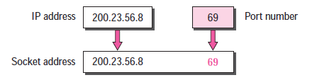
Socket Addresses
The combination of an IP address and a port number is called a socket address.
The client socket address defines the client process uniquely just as the server socket address defines the server process uniquely

Slide 12
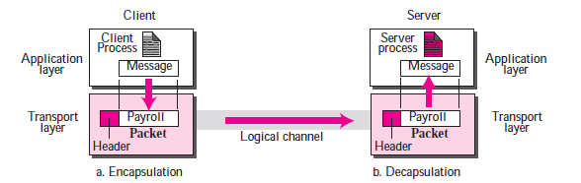
Encapsulation and decapsulation

Slide 13
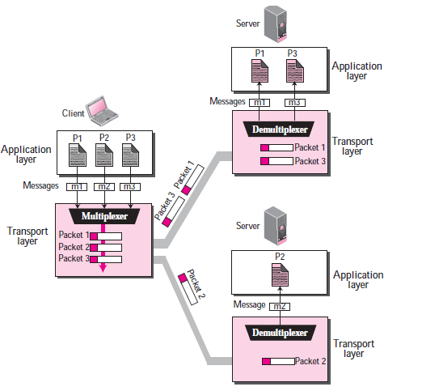
Multiplexing and Demultiplexing
Notes:
Whenever an entity accepts items from more than one source, it is referred to as multiplexing
(many to one); whenever an entity delivers items to more than one source, it
is referred to as demultiplexing (one to many). The transport layer at the source performs
multiplexing; the transport layer at the destination performs demultiplexing

Slide 14
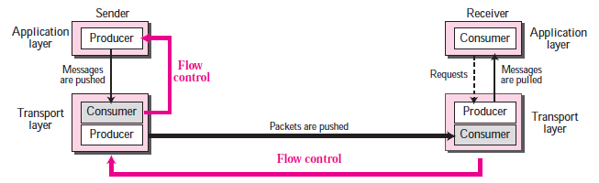
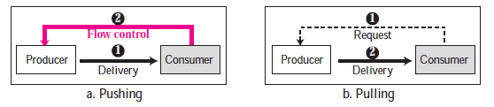
Flow Control
Notes:
Flow Control
Whenever an entity produces items and another entity consumes them, there should be
a balance between production and consumption rates. If the items are produced faster
than they can be consumed, the consumer can be overwhelmed and needs to discard
some items. If the items are produced slower than they can be consumed, the consumer
should wait; the system becomes less efficient. Flow control is related to the first issue.
We need to prevent losing the data items at the consumer site.
Flow Control at Transport Layer
In communication at the transport layer, we are dealing with four entities: sender process,
sender transport layer, receiver transport layer, and receiver process. The sending
process at the application layer is only a producer. It produces message chunks and
pushes them to the transport layer. The sending transport layer has a double role: it is
both a consumer and the producer. It consumes the messages pushed by the producer. It
encapsulates the messages in packets and pushes them to the receiving transport layer.
The receiving transport layer has also a double role: it is the consumer for the packets
received from the sender. It is also a producer; it needs to decapsulate the messages and
deliver them to the application layer. The last delivery, however, is normally a pulling
delivery; the transport layer waits until the application-layer process asks for messages.
Buffers
Although flow control can be implemented in several ways, one of the solutions is normally
to use two buffers. One at the sending transport layer and the other at the receiving
transport layer
The flow control communication can occur by sending signals
from the consumer to producer.
When the buffer of the sending transport layer is full, it informs the application
layer to stop passing chunks of messages; when there are some vacancies, it informs
the application layer that it can pass message chunks again.
When the buffer of the receiving transport layer is full, it informs the sending
transport layer to stop sending packets. When there are some vacancies, it informs the
sending transport layer that it can send message again.
When the producer pushes the items, the consumer may be overwhelmed and there
is a need for flow control, in the opposite direction, to prevent the discarding of the
items. In other words, the consumer needs to warn the producer to stop the delivery and
to inform it when it is ready again to receive the items

Slide 15
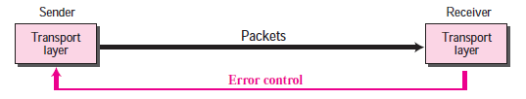
Error Control
Error control at the transport layer is responsible to
1. Detect and discard corrupted packets.
2. Keep track of lost and discarded packets and resend them.
3. Recognize duplicate packets and discard them.
4. Buffer out-of-order packets until the missing packets arrive.
The packets must be numbered in order to know which packets are duplicate/missing(so that resent)/ out of order.
Sequence number field in TCP packet allows to identify packet number.
Receiver use Acknowledgements to inform sender about the sound & safe arrival of the packet.
Notes:
Error control requires that the sending transport layer knows which packet is to be
resent and the receiving transport layer knows which packet is a duplicate, or which
packet has arrived out of order. This can be done if the packets are numbered.
Acknowledgment
We can use both positive and negative signals as error control. The receiver side can
send an acknowledgement (ACK) for each or a collection of packets that have arrived
safe and sound. The receiver can simply discard the corrupted packets. The sender can
detect lost packets if it uses a timer. When a packet is sent, the sender starts a timer;
when the timer expires, if an ACK does not arrive before the timer expires, the sender
resends the packet. Duplicate packets can be silently discarded by the receiver. Out-oforder
packets can be either discarded (to be treated as lost packets by the sender), or
stored until the missing ones arrives.

Slide 16
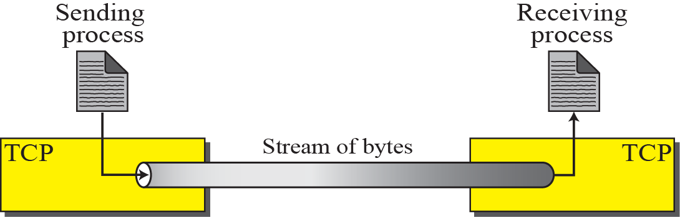
Figure 15.2 Stream delivery
TCP creates environment in which two process seem to be connected by an imaginary “tube”
Message v/s Byte streams
Notes:
TCP creates environment in which two process seem to be connected by an imaginary “tube”
Message and Byte streams are different. In a message stream, the network
keeps track of message boundaries. In a byte stream, it does not. For example,
suppose a process writes 1024 bytes to a connection and then a little later
writes another 1024 bytes. The receiver then does a read for 2048 bytes.
With a message stream, the receiver will get two messages, of 1024 bytes
each. With a byte stream( TCP is Byte Oriented Stream), the message boundaries do not count and the
receiver will get the full 2048 bytes as a single unit.

Slide 17
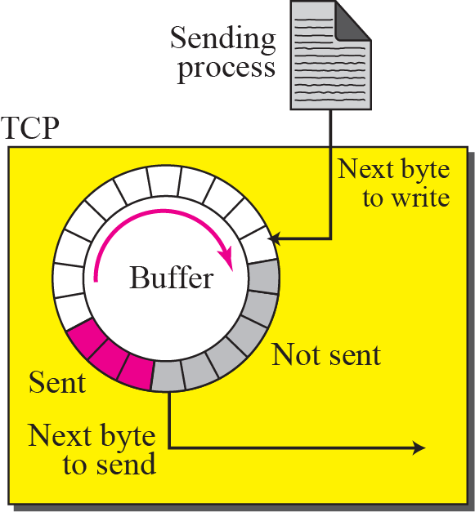
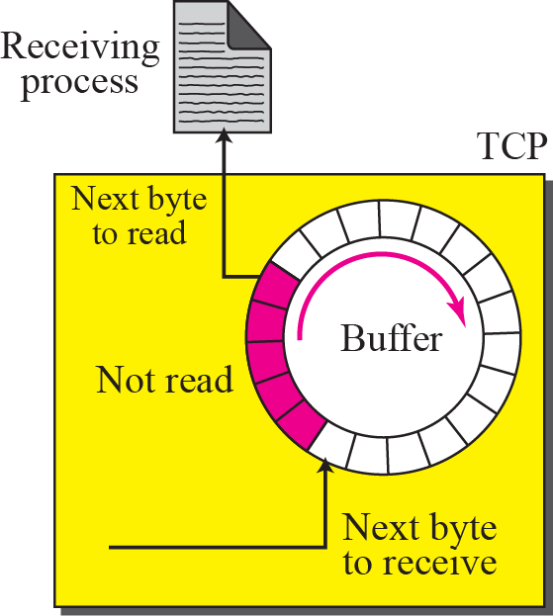
Figure 15.3 Sending and receiving buffers
Notes:
The colored area holds bytes that have
been sent but not yet acknowledged. The TCP sender keeps these bytes in the buffer
until it receives an acknowledgment. The shaded area contains bytes to be sent by the
sending TCP. However, as we will see later in this chapter, TCP may be able to send
only part of this shaded section. This could be due to the slowness of the receiving process,
or congestion in the network. Also note that after the bytes in the colored chambers
are acknowledged, the chambers are recycled and available for use by the sending
process. This is why we show a circular buffer.
The operation of the buffer at the receiver is simpler. The circular buffer is divided
into two areas (shown as white and colored). The white area contains empty chambers
to be filled by bytes received from the network. The colored sections contain received
bytes that can be read by the receiving process. When a byte is read by the receiving
process, the chamber is recycled and added to the pool of empty chambers.

Slide 18
Figure 15.4 TCP segments
Notes:
The IP layer, as a service provider for TCP, needs to send data in packets, not as a stream of bytes. At the
transport layer, TCP groups a number of bytes together into a packet called a segment.
What is maximum segment size (MSS)? - The maximum segment size (MSS) is the largest amount of data specified in bytes that a communication device can receive in single, unfragmented packet. - This Maximum Segment Size (MSS) announcement is sent in SYN packet notifying remote end that "I can accept TCP segments up to specific size in bytes”. - The MSS advertised by each end can be different depending on their configuration. - The MSS is only data portion in the packet, it does not include the TCP header or the IP header. MSS = MTU – size of(TCPHDR) – size of(IPHDR) – size of (IPSEC)* *if IP SEC (IP Security –Authentication Header AH) is enabled

Slide 19
Full-Duplex Communication
TCP offers full duplex services, where data can flow in both directions at the same time.
Each TCP has a sending and receiving buffer and segments move in both directions.
Notes:
TCP offers full-duplex service, where data can flow in both directions at the same time.
Each TCP endpoint then has its own sending and receiving buffer, and segments move in
both directions.

Slide 20
Connection – Oriented Service…
When two processes wants to communicate, the following occurs:
The two TCP’s establish a connection between them.
Data are exchanged in both directions
The connection is terminated.
Note that the connection established is a virtual connection and not a physical connection.
TCP is a reliable protocol, uses numbering bytes and acknowledgement mechanism to check the safe and sound arrival of data.
Notes:
TCP creates a stream-oriented environment in which it accepts
the responsibility of delivering the bytes in order to the other site.

Slide 21
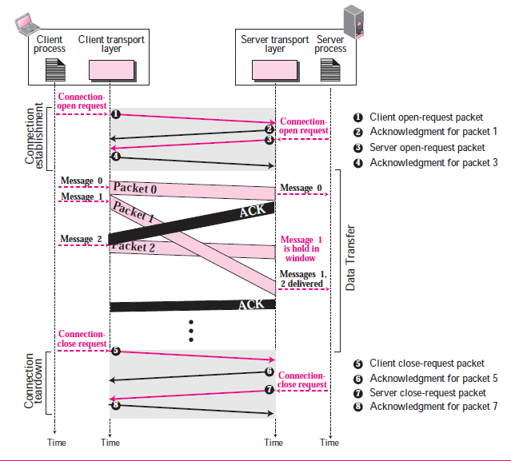
…Connection – Oriented Service
Notes:
Connection-Oriented Service
In a connection-oriented service, the client and the server first need to establish a connection
between themselves. The data exchange can only happen after the connection establishment.
After data exchange, the connection needs to be teared down.
The connection-oriented service at the transport layer is different from the same service at the network layer.
In the network layer, connection-oriented service means a coordination between the two end hosts and all the routers in
between. At the transport layer, connection-oriented service involves only the two
hosts; the service is end to end. This means that we should be able to make a
connection-oriented protocol over either a connectionless(connection less Packet switching) or connection-oriented
Protocol(At N/W layer –either Virtual Circuit ). Figure 13.14 shows the connection establishment, data transfer, and teardown
phases in a connection-oriented service at the transport layer. Note that most protocols
combine the third and fourth packets in the connection establishment phase into
one packet

Slide 22
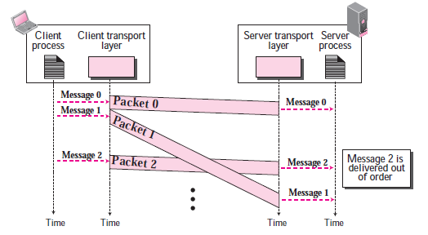
Connectionless service
Notes:
The figure shows that at the client site, the three chunks of messages are delivered
to the client transport layer in order (1, 2, and 3). Because of the extra delay in transportation
of the second packet, the delivery of messages at the server is not in order (1, 3,
2). If these three chunks of data belong to the same message, the server process may
have received a strange message The situation would be worse if one of the packets were lost. Since there is no
numbering on the packets, the receiving transport layer has no idea that one of the messages
has been lost. It just delivers two chunks of data to the server process.
The above two problems arise from the fact that the two transport layers do not
coordinate with each other. The receiving transport layer does not know when the first
packet will come nor when all of the packets have arrived.
We can say that no flow control, error control, or congestion control can be effectively
implemented in a connectionless service.

Slide 23
TCP FEATURES
To provide the services mentioned in the previous section, TCP has several features that are briefly summarized in this section and discussed later in detail.

Slide 24
Numbering System
Although the TCP Software keeps track of the segments being transmitted or received, there is no field for a segment number value in the segment header.
Instead there are two fields called the sequence number and the acknowledgement number.
These two fields are referred to as byte number.

Slide 25

Byte Number
Note
The bytes of data being transferred in each connection are numbered by TCP.
The numbering starts with an arbitrarily generated number.

Slide 26
Sequence Number
Note
The value in the sequence number field of a segment defines the number assigned to the first data byte contained in that segment.

Slide 27
Example 15.1
Suppose a TCP connection is transferring a file of 5,000 bytes. The first byte is numbered 10,001. What are the sequence numbers for each segment if data are sent in five segments, each carrying 1,000 bytes?
Solution
The following shows the sequence number for each segment:

Slide 28
Acknowledgement Number
Note
The value of the acknowledgment field in a segment defines the number of the next byte a party expects to receive.
The acknowledgment number is cumulative.
Notes:
The term cumulative here
means that if a party uses 5,643 as an acknowledgment number, it has received all bytes
from the beginning up to 5,642.

Slide 29
SEGMENT
Before discussing TCP in more detail, let us discuss the TCP packets themselves. A packet in TCP is called a segment.
Notes:
What is maximum segment size (MSS)? - The maximum segment size (MSS) is the largest amount of data specified in bytes that a communication device can receive in single, unfragmented packet. - This Maximum Segment Size (MSS) announcement is sent in SYN packet notifying remote end that "I can accept TCP segments up to specific size in bytes”. - The MSS advertised by each end can be different depending on their configuration. - The MSS is only data portion in the packet, it does not include the TCP header or the IP header. MSS = MTU – size of(TCPHDR) – size of(IPHDR) – size of (IPSEC)* *if IP SEC (IP Security –Authentication Header AH) is enabled

Slide 30
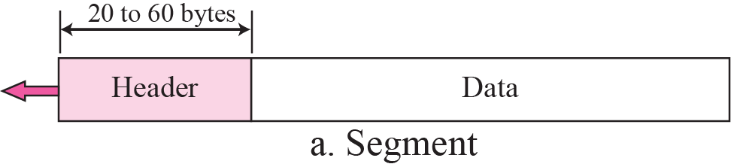
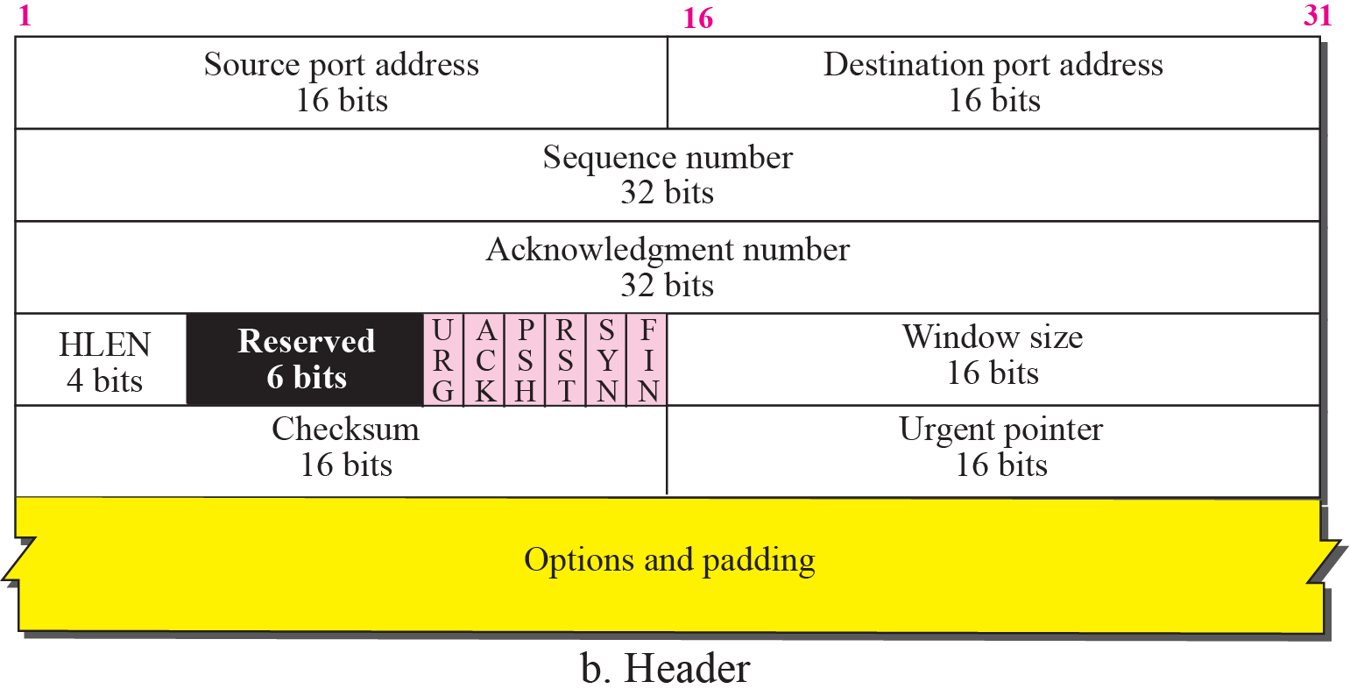
Figure 15.5 TCP segment format
The header is 20 bytes if
there are no options and up to 60 bytes if it contains options.
Notes:
Header length. This 4-bit field indicates the number of 4-byte words in the TCP
header. The length of the header can be between 20 and 60 bytes. Therefore, the
value of this field is always between 5 (5× 4= 20) and 15 (15× 4= 60).
Reserved. This is a 6-bit field reserved for future use.

Slide 31
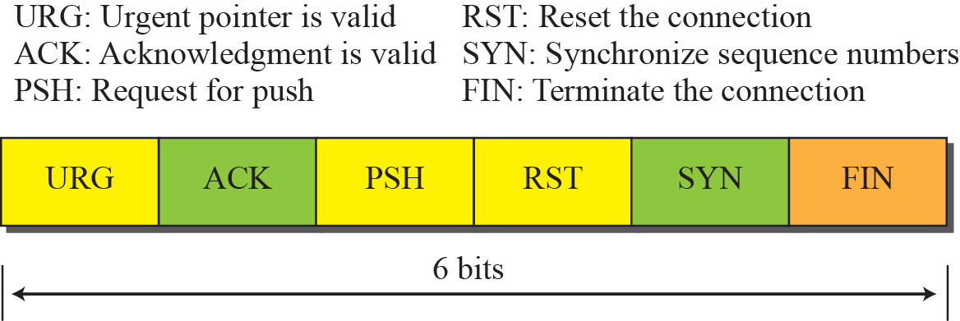
Figure 15.6 Control field
One or more of these bits can be set at a time. These bits enable flow control, connection establishment and termination, connection abortion, and the mode of data transfer in TCP.
Notes:
Urgent pointer. This 16-bit field, which is valid only if the urgent flag is set, is
used when the segment contains urgent data. It defines a value that must be added
to the sequence number to obtain the number of the last urgent byte in the data section
of the segment.
URG If set, the Urgent Pointer fi eld value is valid (often resulting from an interrupt-like
CTRL-C). Seldom used, but intended to raise the priority of the segment.
Urgent Data page446 (pdf)
TCP is a stream-oriented protocol. This means that the data is presented from the application
program to TCP as a stream of bytes. Each byte of data has a position in the
stream. However, there are occasions in which an application program needs to send
urgent bytes, some bytes that need to be treated in a special way by the application at
the other end. The solution is to send a segment with the URG bit set. The sending
application program tells the sending TCP that the piece of data is urgent. The sending
TCP creates a segment and inserts the urgent data at the beginning of the segment. The
rest of the segment can contain normal data from the buffer. The urgent pointer field in
the header defines the end of the urgent data (the last byte of urgent data).
When the receiving TCP receives a segment with the URG bit set, it informs the
receiving application of the situation. How this is done, depends on the operation system.
It is then to the discretion of the receiving program to take an action.
https://www.firewall.cx/networking-topics/protocols/tcp/136-tcp-flag-options.html
1ST FLAG - URGENT POINTER
The first flag is the Urgent Pointer flag, as shown in the previous screen shot. This flag is used to identify incoming data as 'urgent'. Such incoming segments do not have to wait until the previous segments are consumed by the receiving end but are sent directly and processed immediately.
An Urgent Pointer could be used during a stream of data transfer where a host is sending data to an application running on a remote machine. If a problem appears, the host machine needs to abort the data transfer and stop the data processing on the other end. Under normal circumstances, the abort signal will be sent and queued at the remote machine until all previously sent data is processed, however, in this case, we need the abort signal to be processed immediately.
By setting the abort signal's segment Urgent Pointer flag to '1', the remote machine will not wait till all queued data is processed and then execute the abort. Instead, it will give that specific segment priority, processing it immediately and stopping all further data processing.
If you're finding it hard to understand, consider this real-life example:
At your local post office, hundreds of trucks are unloading bags of letters from all over the world. Because the amount of trucks entering the post office building are abundant, they line up one behind the other, waiting for their turn to unload their bags.
As a result, the queue ends up being quite long. However, a truck with a big red flag suddenly joins the queue and the security officer, whose job it is to make sure no truck skips the queue, sees the red flag and knows it's carrying very important letters that need to get to their destination urgently. By following the normal procedures, the security officer signals to the truck to skip the queue and go all the way up to the front, giving it priority over the other the trucks.
In this example, the trucks represent the segments that arrive at their destination and are queued in the buffer waiting to be processed, while the truck with the red flag is the segment with the Urgent Pointer flag set.
A further point to note is the existence of theUrgent Pointer field. This field is covered in section 5, but we can briefly mention that when the Urgent Pointer flag is set to '1' (that's the one we are analysing here), then the Urgent Pointer field specifies the position in the segment where urgent data ends.

Slide 32
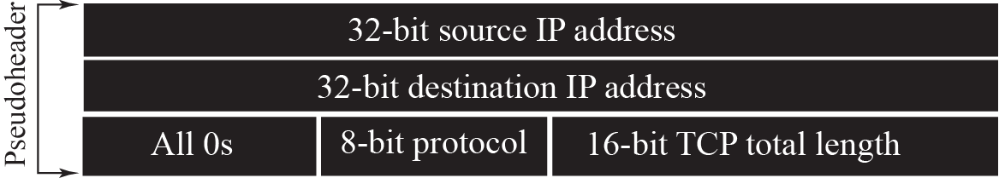
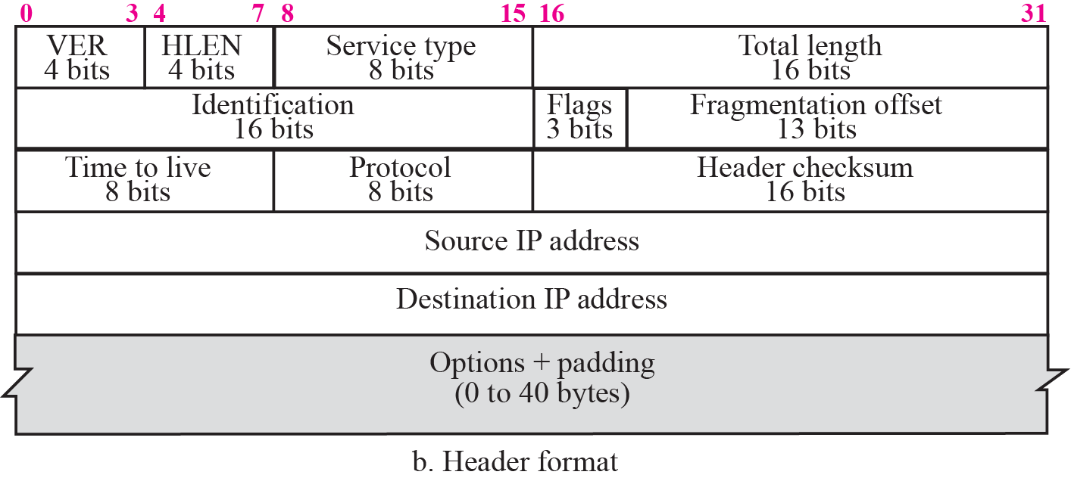
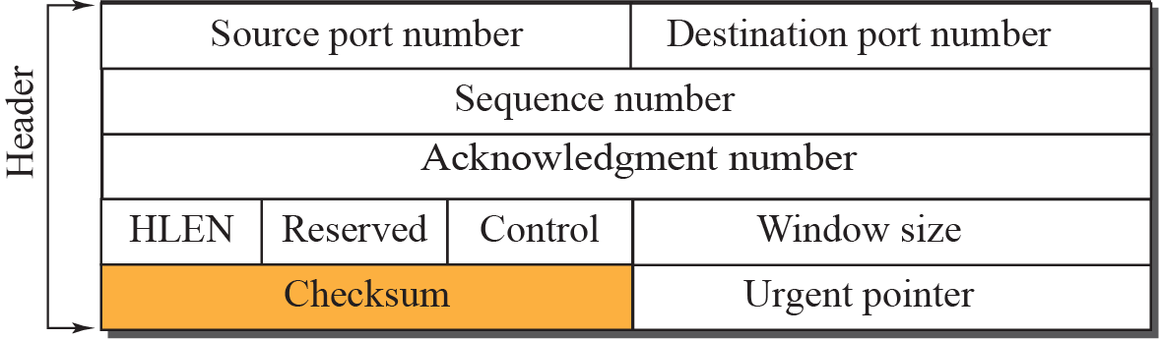

Figure 15.7 Pseudoheader added to the TCP segment
Checksum in the UDP datagram is optional, whereas the use of the checksum for TCP is mandatory.
Options: There can be up to 40 bytes of optional information in the TCP header.
Notes:
It is a pseudo-IP-header, only used for the checksum calculation,
Pseudo IP header: The pseudo-header is not an IP header rather it is a part of the IP header. We directly don’t use the IP header because in IP header there are many which would be continuously changing when then packets move along the network . Thus a part of the IP header is taken into account which don’t change as the IP packet moves in the network.
The Fields of the Pseudo IP header are:-
IP of the Source , IP of the Destination , Fixed of 8-bits , Protocol (stating the type of the protocol used) , TCP/UDP segment Length .
An important concept should be noted that this Pseudo header is created in the Transport layer for calculation and after the calculation is done the Pseudo header is discarded. So, this Pseudo Header is not transported across the network, rather the actual IP header which is formed in Network Layer is transported.
https://www.firewall.cx/networking-topics/protocols/tcp/137-tcp-window-size-checksum.html
THE PSEUDO HEADER
The pseudo header is a combination of 5 different fields, used during the calculation of the TCP checksum. It is important to note (and remember!) that the pseudo header is not transmitted to the receiver, but is simply involved in the checksum calculation.
Here are the 5 fields as they are defined by the TCP RFC:
When the segment arrives at its destination and is processed through the OSI layers, once the transport layer (Layer 4) is reached, the receiver will recreate the pseudo header in order to recalculate the TCP header checksum and compare the result with the value stored in the segment it has received.
If we assume the segment somehow managed to find its way to a wrong machine, when the pseudo header is recreated, the wrong IP Address will be inserted into the Destination IP Address field and the result will be an incorrect calculated checksum. Therefore, the receiver that wasn't supposed to receive the segment will drop it as it's obviously not meant to be there.
Now you know how the checksum field guarantees that the correct host will receive the packet, or that it will get there without any errors!

Slide 33
Note
The use of the checksum in TCP is mandatory.

Slide 34
Figure 15.8 Encapsulation

Slide 35
15-4 A TCP CONNECTION
TCP is connection-oriented. It establishes a virtual path between the source and destination. All of the segments belonging to a message are then sent over this virtual path.
How TCP, which uses the services of IP, a connectionless protocol, can be connection-oriented. The point is that a TCP connection is virtual, not physical.
Notes:
TCP is connection-oriented. It establishes a virtual path between the source and destination. All of the segments belonging to a message are then sent over this virtual path. You may wonder how TCP, which uses the services of IP, a connectionless protocol, can be connection-oriented. The point is that a TCP connection is virtual, not physical. TCP operates at a higher level. TCP uses the services of IP to deliver individual segments to the receiver, but it controls the connection itself. If a segment is lost or corrupted, it is retransmitted.

Slide 36
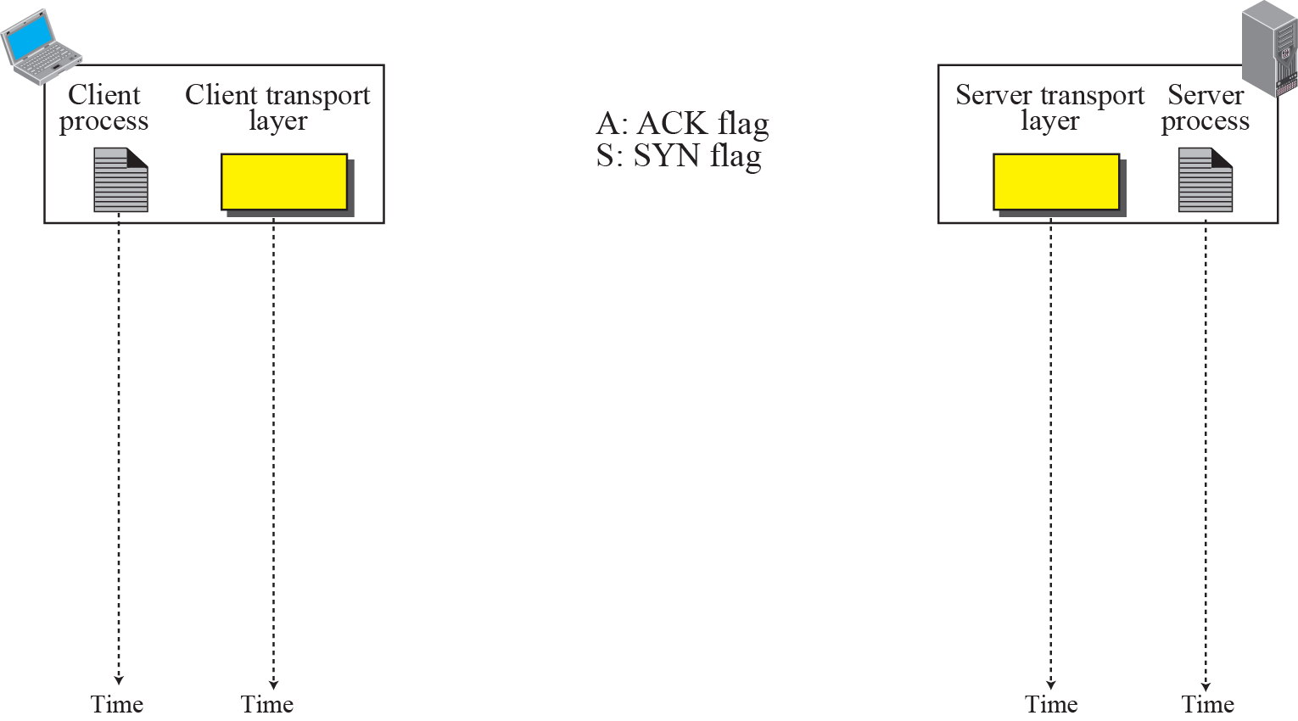

Figure 15.9 Connection establishment using three-way handshake
ISN-Initial Sequence Number
Means “no data” !
seq: 8001 if piggybacking
Notes:
Topic : TCP connection. ISN-Initial Sequence Number
Piggybacking: If the data traveling in the same direction as an acknowledgment are carried on the same segment.
The acknowledgment is piggybacked with the data.
To ride piggyback is to hang on to someone's shoulders as they carry you on their back. ... Experts think piggyback comes from pick a back and the even earlier pick pack (think "backpack")
The connection establishment in TCP is called three-way handshaking. In our example,
an application program, called the client, wants to make a connection with another
application program, called the server, using TCP as the transport layer protocol.
The process starts with the server. The server program tells its TCP that it is ready
to accept a connection. This request is called a passive open. Although the server TCP
is ready to accept a connection from any machine in the world, it cannot make the
connection itself.
The client program issues a request for an active open. A client that wishes to connect
to an open server tells its TCP to connect to a particular server. TCP can now start
the three-way handshaking process as shown in Figure 15.9.
The three steps in this phase are as follows.
1. The client sends the first segment, a SYN segment, in which only the SYN flag is
set. This segment is for synchronization of sequence numbers. The client in our
example chooses a random number as the first sequence number and sends this
number to the server. This sequence number is called the initial sequence number
(ISN). Note that this segment does not contain an acknowledgment number. It does
not define the window size either; a window size definition makes sense only when
a segment includes an acknowledgment. The segment can also include some
options that we discuss later in the chapter. Note that the SYN segment is a control
segment and carries no data. However, it consumes one sequence number. When
the data transfer starts, the ISN is incremented by 1. We can say that the SYN segment
carries no real data, but we can think of it as containing one imaginary byte.
2. The server sends the second segment, a SYN + ACK segment with two flag bits set:
SYN and ACK. This segment has a dual purpose. First, it is a SYN segment for communication
in the other direction. The server uses this segment to initialize a sequence
number for numbering the bytes sent from the server to the client. The server also
acknowledges the receipt of the SYN segment from the client by setting the ACK flag
and displaying the next sequence number it expects to receive from the client.
Because it contains an acknowledgment, it also needs to define the receive window
size, rwnd (to be used by the client), as we will see in the flow control section.
3. The client sends the third segment. This is just an ACK segment. It acknowledges
the receipt of the second segment with the ACK flag and acknowledgment number
field. Note that the sequence number in this segment is the same as the one in the
SYN segment; the ACK segment does not consume any sequence numbers. The
client must also define the server window size. Some implementations allow this
third segment in the connection phase to carry the first chunk of data from the
client. In this case, the third segment must have a new sequence number showing
the byte number of the first byte in the data. In general, the third segment usually
does not carry data and consumes no sequence numbers.

Slide 37
Note
A SYN segment cannot carry data, but it consumes one sequence number.
Notes:
Note that the SYN segment is a control
segment and carries no data. However, it consumes one sequence number. When
the data transfer starts, the ISN is incremented by 1. We can say that the SYN segment
carries no real data, but we can think of it as containing one imaginary byte.

Slide 38
Note
A SYN + ACK segment cannot carry data, but does consume one sequence number.
Notes:
The server sends the second segment, a SYN + ACK segment with two flag bits set:
SYN and ACK. This segment has a dual purpose. First, it is a SYN segment for communication
in the other direction. The server uses this segment to initialize a sequence
number for numbering the bytes sent from the server to the client. The server also
acknowledges the receipt of the SYN segment from the client by setting the ACK flag
and displaying the next sequence number it expects to receive from the client.
Because it contains an acknowledgment, it also needs to define the receive window
size, rwnd (to be used by the client

Slide 39
Note
An ACK segment, if carrying no data, consumes no sequence number.

Slide 40
SOCKET CONNECTION ESTABLISHMENT and PACKET EXCHANGE
Notes:
SOCKET CONNECTION ESTABLISHMENT and PACKET EXCHANGE
We show the client's initial sequence number as J and the server's initial sequence number as
K. The acknowledgment number in an ACK is the next expected sequence number for the end
sending the ACK. Since a SYN occupies one byte of the sequence number space, the
acknowledgment number in the ACK of each SYN is the initial sequence number plus one.
Similarly, the ACK of each FIN is the sequence number of the FIN plus one.
An everyday analogy for establishing a TCP connection is the telephone system [Nemeth
1997]. The socket function is the equivalent of having a telephone to use. bind is telling
other people your telephone number so that they can call you. listen is turning on the ringer
so that you will hear when an incoming call arrives. connect requires that we know the other
person's phone number and dial it. accept is when the person being called answers the phone.
Having the client's identity returned by accept (where the identify is the client's IP address
and port number) is similar to having the caller ID feature show the caller's phone number.
One difference, however, is that accept returns the client's identity only after the connection has
been established, whereas the caller ID feature shows the caller's phone number before we
choose whether to answer the phone or not. If the DNS is used (Chapter 11), it provides a
service analogous to a telephone book. getaddrinfo is similar to looking up a person's phone
number in the phone book. getnameinfo would be the equivalent of having a phone book
sorted by telephone numbers that we could search, instead of a book sorted by name.
In our scenario, the server process issues an open command. This
must happen before the client issues an open command. The server TCP goes to the
LISTEN state and remains there, passively, until it receives a SYN segment. When the
server TCP receives a SYN segment, it sends a SYN+ACK segment and goes to SYNRCVD
state, waiting for the client to send an ACK segment. After receiving the ACK
segment, it goes to ESTABLISHED state, where data transfer can take place.
Note that although either side (client or server) may initiate the close, we assume
that the client initiates the close without loss of generality.

Slide 41
SYN flooding Attack:
One or more malicious attackers send a large number of SYN segments to a server pretending that each of them is coming from a different client by faking the source IP addresses in the datagrams.
The server, assuming that the clients are issuing an active open, allocates the necessary resources, such as creating transfer control block(TCB) and setting timers.
The TCP server then sends the SYN + ACK segments to the fake clients,
which are lost. When the server waits for the third phase of the handshaking process
Soon Server runs out of resources and not able to accept connection from genuine Clients
This SYN flooding attack belongs to a group of security attacks known as a denial of service (DoS) attack
Notes:
Soon Server runs out of resources and not able to accept connection from genuine Clients.
The server,
assuming that the clients are issuing an active open, allocates the necessary resources,
such as creating transfer control block (TCB) tables (explained later in the chapter) and
setting timers.
Page-490
To control the connection, TCP uses a structure to hold information
about each connection. This is called a transmission control block (TCB). Because at
any time there can be several connections, TCP keeps an array of TCBs in the form of a table.
Some fields in TCB table - Buffer Size and Buffer Pointer which points to Buffer allocated(advertised as rwnd) where received data is kept
The TCP server then sends the SYN + ACK segments to the fake clients,
which are lost. When the server waits for the third leg of the handshaking process, however,
resources are allocated without being used. If, during this short period of time, the
number of SYN segments is large, the server eventually runs out of resources and may be
unable to accept connection requests from valid clients. This SYN flooding attack
belongs to a group of security attacks known as a denial of service attack

Slide 42
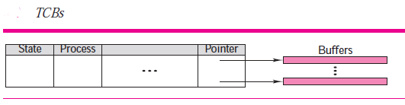
TCBs
A connection may be open for a long period of time. To control the connection, TCP uses a structure to hold information about each connection.
This is called a transmission control block (TCB). Because at any time there can be several connections, TCP keeps an array of TCBs in the form of a table.
Buffer pointer This field is a pointer to the buffer where the received data are kept until they are read by the application.
Notes:
TCBs – more details – under TCP Software package( page 490 Soft copy Book)

Slide 43
Figure 15.9 Connection establishment using three-way handshake
After Connection Establishment-Data Transfer next slide
Means “no data” !
seq: 8001 if piggybacking
Notes:
Topic : TCP connection.
After Connection Establishment-Data Transfer next slide
The connection establishment in TCP is called three-way handshaking. In our example,
an application program, called the client, wants to make a connection with another
application program, called the server, using TCP as the transport layer protocol.
The process starts with the server. The server program tells its TCP that it is ready
to accept a connection. This request is called a passive open. Although the server TCP
is ready to accept a connection from any machine in the world, it cannot make the
connection itself.
The client program issues a request for an active open. A client that wishes to connect
to an open server tells its TCP to connect to a particular server. TCP can now start
the three-way handshaking process as shown in Figure 15.9.
The three steps in this phase are as follows.
1. The client sends the first segment, a SYN segment, in which only the SYN flag is
set. This segment is for synchronization of sequence numbers. The client in our
example chooses a random number as the first sequence number and sends this
number to the server. This sequence number is called the initial sequence number
(ISN). Note that this segment does not contain an acknowledgment number. It does
not define the window size either; a window size definition makes sense only when
a segment includes an acknowledgment. The segment can also include some
options that we discuss later in the chapter. Note that the SYN segment is a control
segment and carries no data. However, it consumes one sequence number. When
the data transfer starts, the ISN is incremented by 1. We can say that the SYN segment
carries no real data, but we can think of it as containing one imaginary byte.
2. The server sends the second segment, a SYN + ACK segment with two flag bits set:
SYN and ACK. This segment has a dual purpose. First, it is a SYN segment for communication
in the other direction. The server uses this segment to initialize a sequence
number for numbering the bytes sent from the server to the client. The server also
acknowledges the receipt of the SYN segment from the client by setting the ACK flag
and displaying the next sequence number it expects to receive from the client.
Because it contains an acknowledgment, it also needs to define the receive window
size, rwnd (to be used by the client), as we will see in the flow control section.
3. The client sends the third segment. This is just an ACK segment. It acknowledges
the receipt of the second segment with the ACK flag and acknowledgment number
field. Note that the sequence number in this segment is the same as the one in the
SYN segment; the ACK segment does not consume any sequence numbers. The
client must also define the server window size. Some implementations allow this
third segment in the connection phase to carry the first chunk of data from the
client. In this case, the third segment must have a new sequence number showing
the byte number of the first byte in the data. In general, the third segment usually
does not carry data and consumes no sequence numbers.

Slide 44
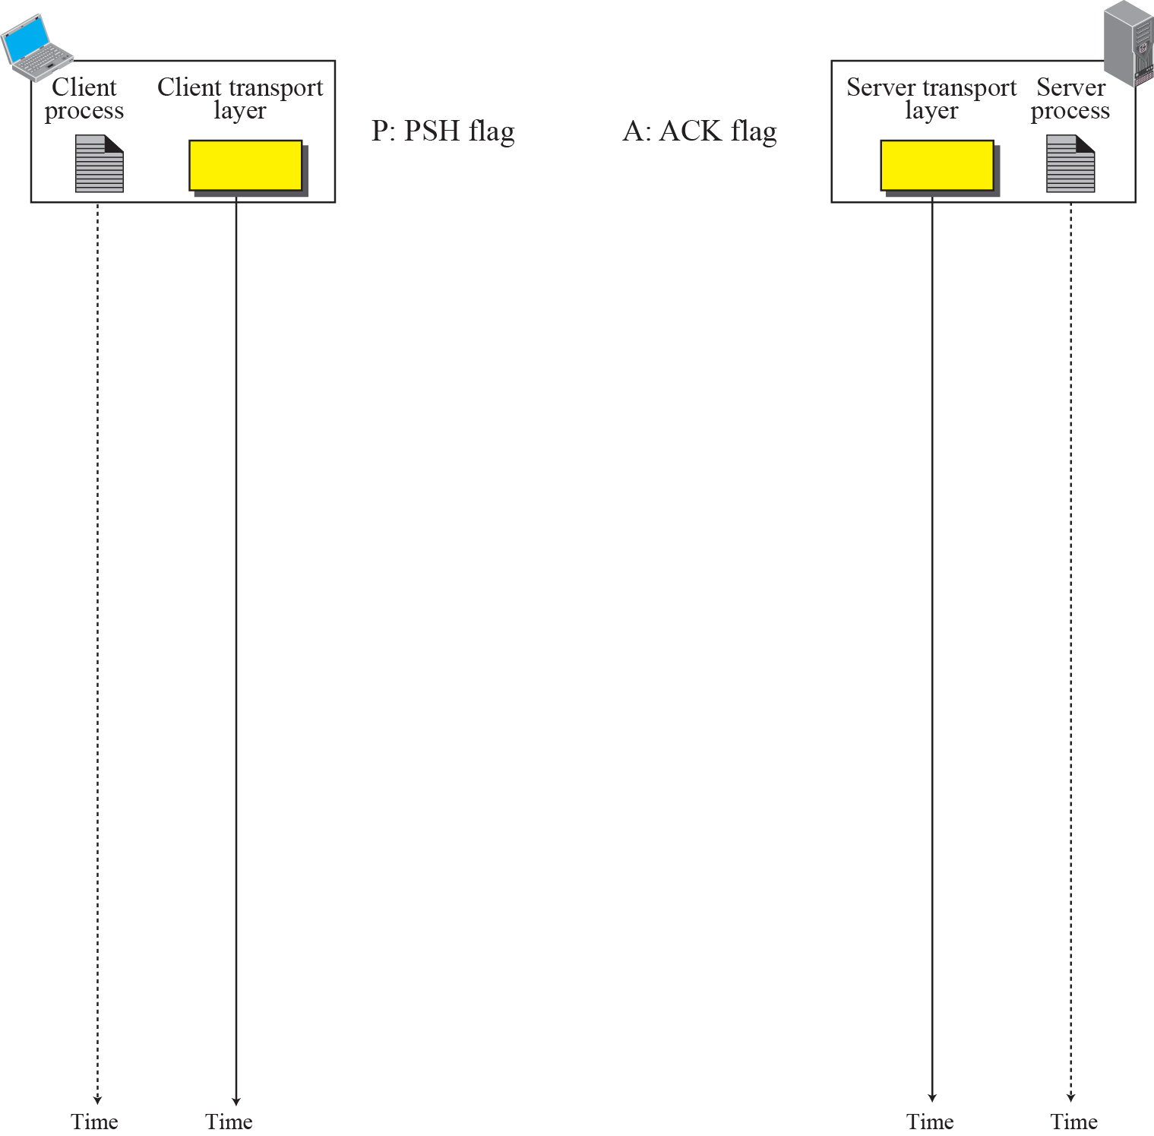
Figure 15.10 Data Transfer (assume Connection is already established)
In each segment note the Seq. Number, ACK number & other Control bits set.
No Data, Do not Consume Seq No.
Notes:
No Data, Do not Consume Seq No.
In each segment note the Seq Number, ACK number & other Control bits set.
PSH If set, the receiver should not buffer the segment data, but pass them directly to the
application. Interactive applications use this, but few others.

Slide 45
Pushing Data
The sending TCP uses a buffer to store the stream of data coming from the sending application and can select a segment size.
Certain applications(interactive applications) cannot sustain delayed transmissions and delayed delivery of data. In such situations the PSH flag is set.
When the application program at the sending site request a push operation, it means that the sending TCP must not wait for the window to be filled and it must create a segment and send it immediately.
The sending TCP must also set PSH and sends segment, it is indication to Receiver TCP that do not buffer data, immediately deliver to Receiver Application
Notes:
The application program at the sender can request a push operation. This means that the sending TCP must not wait for the window to be
filled. It must create a segment and send it immediately. (most TCP ignore such PSH request from Application)
Now Sender TCP set PSH and sends immediately. If PSH set segment is received then the receiver should not buffer the segment data and waiting some more data to come , but pass data immediately to the application. Interactive applications use this, but few others.
Key Concept: TCP is designed to restrict the size of the segments it sends to a certain maximum limit, to cut down on the likelihood that segments will need to be fragmented for transmission at the IP level. The TCP maximum segment size (MSS) specifies the maximum number of bytes in the TCP segment’s Data field, regardless of any other factors that influence segment size. The default MSS for TCP is 536, which results from taking the minimum IP MTU of 576 and subtracting 20 bytes each for the IP and TCP headers.

Slide 46
URGENT DATA
We know that the data is presented from the application layer as stream of bytes to TCP ( stream – oriented protocol).
Each byte of data has a position in the stream.
There may be occasions in which the application program needs to send urgent bytes, i.e., the sending application program wants a piece of data to be treated in special way by the receiving application program.
The solution is to send a segment with URG bit set.
In this way the sending application tells the sending TCP that the piece of data is urgent and the sending TCP creates a segment inserts the urgent data in the beginning and fills the remaining segment with normal data.
The Urgent pointer field in the header defines the end of the urgent data
The receiving TCP using the Urgent Pointer extracts the urgent data and delivers it to the receiving application.
It is then to the discretion of the receiving program to take an action.
Notes:
URG If set, the Urgent Pointer field value is valid (often resulting from an interrupt-like
CTRL-C). Seldom used, but intended to raise the priority of the segment.

Slide 47
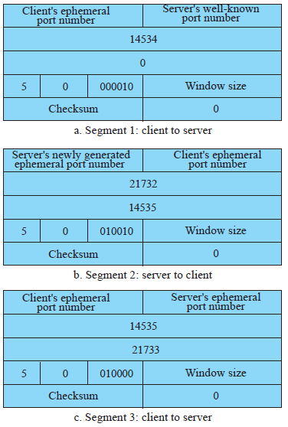
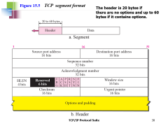
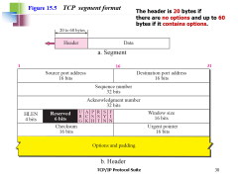
TCP client opens a connection using an initial sequence number (ISN) of 14,534. The other party(server) opens the connection with an ISN of 21,732. Show the three TCP segments during the connection establishment.
SYN bit set
ACK & SYN bit set
Note: Segment 3 client to server Ack number is 14534(No data)
ACK bit set
Notes:
UAPRSF
ACK & SYN bit set

Slide 48
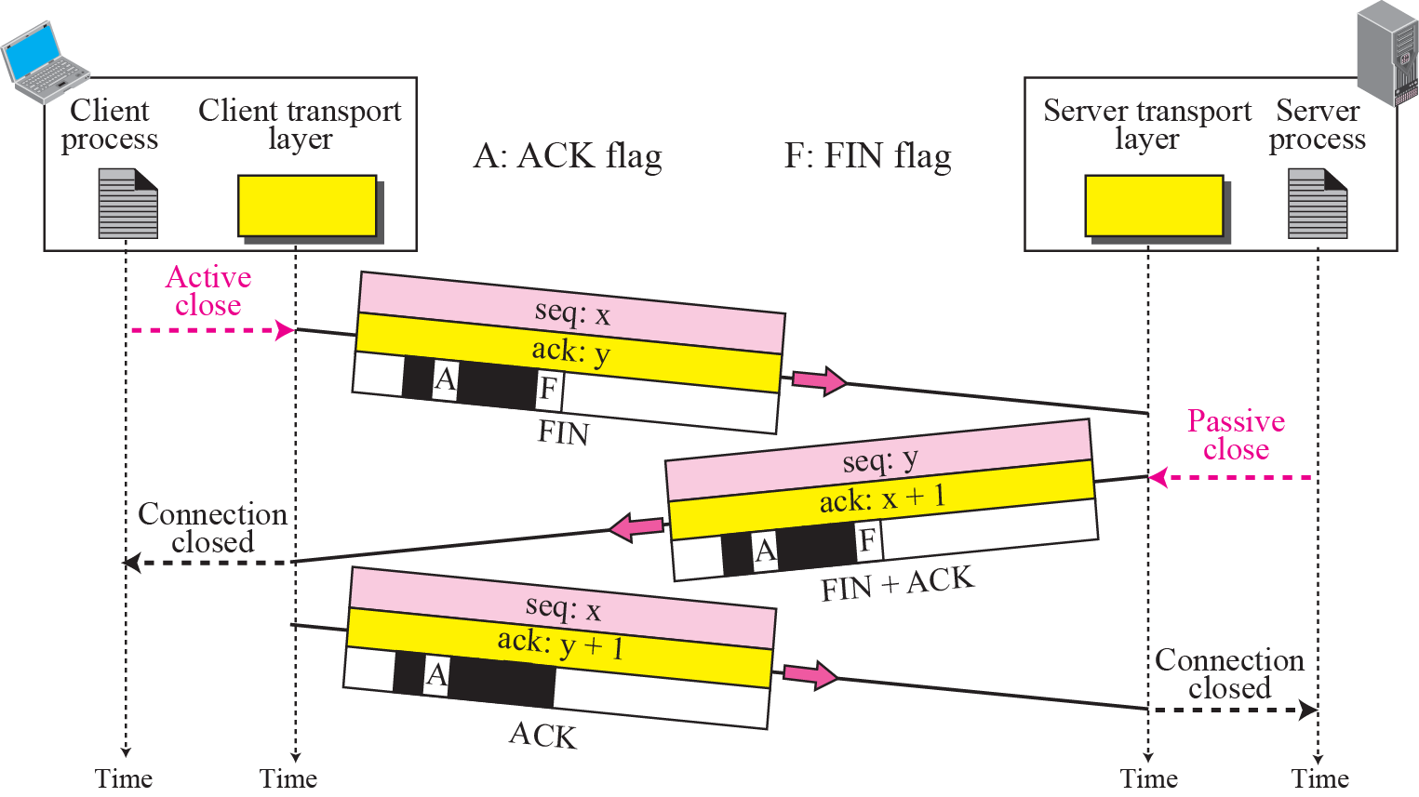
Figure 15.11
Connection termination using three-way handshake
May include last
data chunk from client
May include last
data chunk from server
This segment cannot carry data and
Notes:
May include last data chunk , FIN consume 1 Seq No
The FIN segment consumes 1 sequence number if it does not carry data.
The FIN + ACK segment consumes 1 sequence number if it does not carry data.

Slide 49
Note
The FIN segment consumes one sequence number if it does not carry data.

Slide 50
Note
The FIN + ACK segment consumes one sequence number if it does not carry data.
Notes:
**

Slide 51
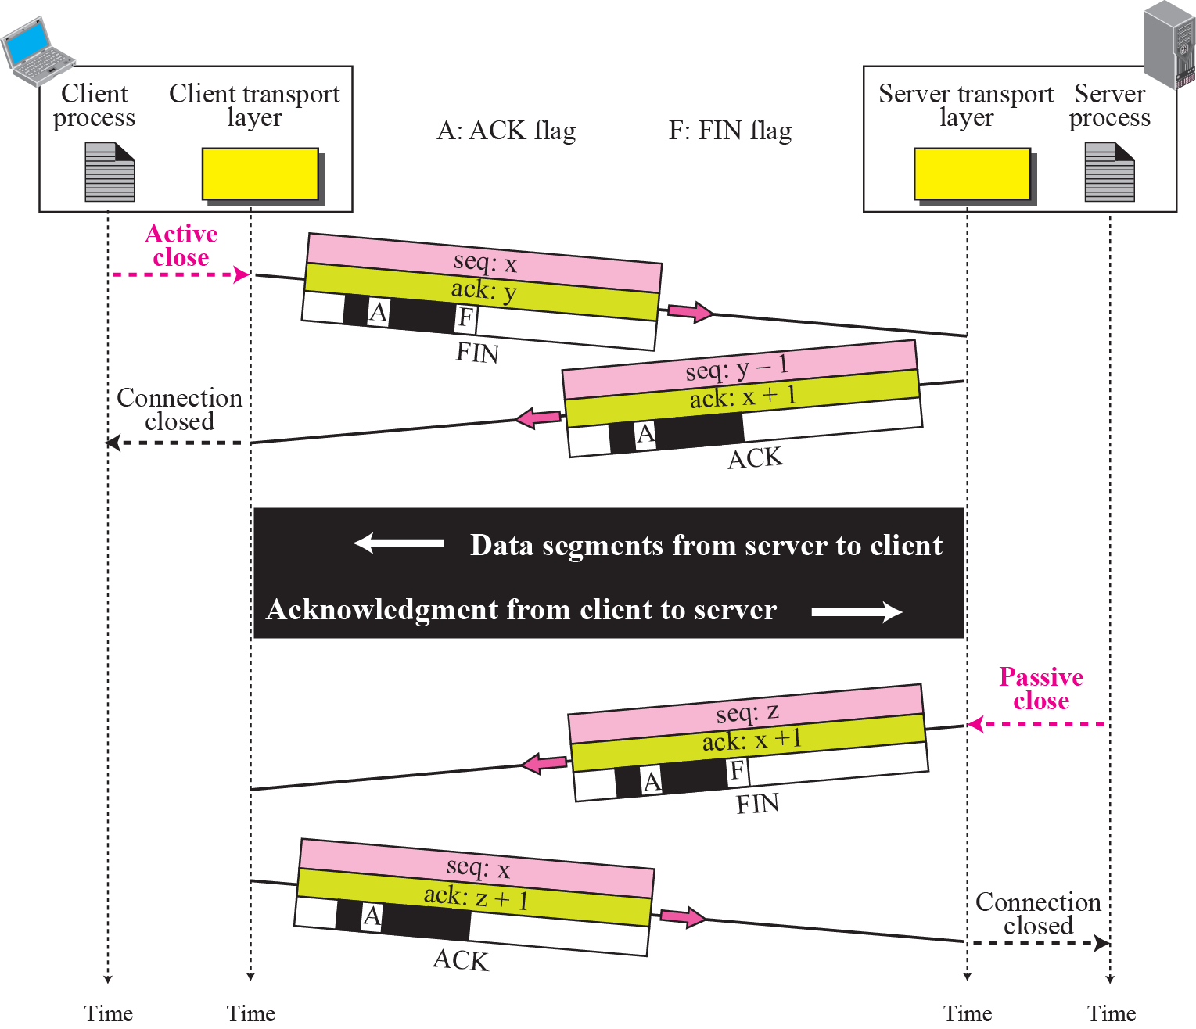
Figure 15.12 Half-Close
Notes:
#Half-Close
In TCP, one(for example client) end can stop sending data while (client) still receiving data. This is called a halfclose.
Either the server or the client can issue a half-close request. It can occur when the
server needs all the data before processing can begin. A good example is sorting. When
the client sends data to the server to be sorted, the server needs to receive all the data
before sorting can start. This means the client, after sending all data, can close the connection
in the client-to-server direction. However, the server-to-client direction must
remain open to return the sorted data. The server, after receiving the data, still needs
time for sorting; its outbound direction must remain open.
In Packet from Client to server, if y=1000 means , data up-to 999 is received and next expecting data starting with byte number 1000
In ACK received from Client previously, if y=1000 means , data up-to 999 is received and next expecting data starting with byte number 1000.
Since server not sending any data, therefore Seq number not changed to y(i.e 1000) instead it is 999(i.e y-1) only

Slide 52
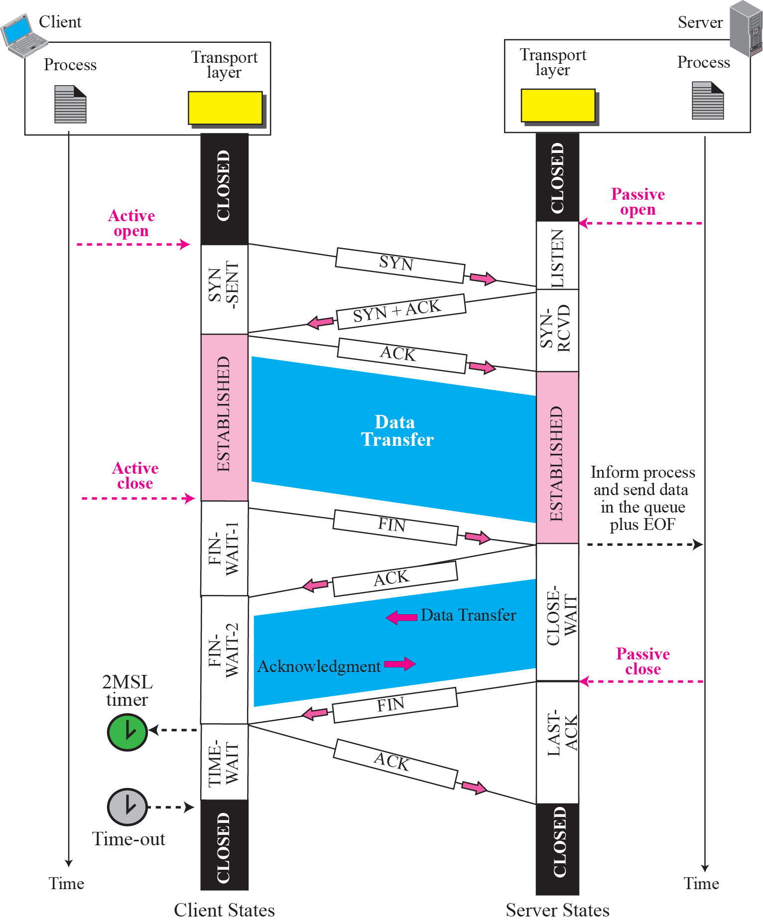
Figure 15.15 Time-line diagram for connection establishment and half-close termination
1. Enough time for an ACK to be lost and a new FIN to arrive. If during the TIME-WAIT state, a new FIN arrives, the client sends a new ACK and restarts the 2MSL timer
To prevent a duplicate segment from one connection appearing in the next one, TCP requires that incarnation cannot take place unless 2MSL amount of time has elapsed.
Another solution: the ISN of the incarnation is greater than the last seq. # used in the previous connection.
Notes:
MSL-maximum Segment Lifetime-
Remember that a TCP segment is encapsulated in an IP
datagram, which has a limited lifetime (TTL). When the IP datagram is dropped, the
encapsulated TCP segment is also dropped. The common value for MSL is between
30 seconds and 1 minute. There are two reasons for the existence of the TIME-WAIT
state and the 2SML timer:

